Slide 1
Common Information Sharing Environment
Enhancing maritime domain awareness and responsiveness in Europe
Franco Oliveri
EUCISE 2020 – Industry Day
Bruxelles, September, 23rd

Slide 2
Common Information Sharing Environment (CISE) for Maritime Surveillance
The CISE aims at creating a
political, cultural, legal and technical
environment
to enable information sharing
between existing and future surveillance systems and networks

Slide 3
Motivation
To have more data is important
To have them at the very moment they are needed is crucial
Computers could automatically exchange most of the data needed by the users
Human intervention should be kept to a minimum, ensuring the control of the information exchange rules

Slide 4
To exchange information,
Interoperability is the key word
The European Interoperability framework identifies four levels of interoperability:
Legal interoperability
Organisational Interoperability
Semantic Interoperability
Technical Interoperability

Slide 5

Semantic Interoperability
Computers, like human beings, do not understand each other if they speak different languages.
Our satellite images show that the collision caused a large oil leakage.
We have assets there, let us know how we can support your operations.
There has been a collision involving two vessels in front of Olbia
Entschuldigung, was hast du gerade gesagt?
C’e’ stata una collisione che ha coinvolto due navi al largo di Olbia
Pardon? Qu'est-ce que tu as dit?
First step: common language, i.e. standardized Data Model

Slide 6


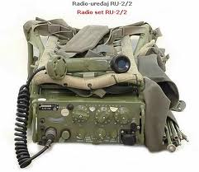


Technical Interoperability
Computers do not understand each other if they use different communication means.
Second step: common communication means

Slide 7
What will CISE be made of?
some hardware (for interfacing to the network)
quite a bit of software
but mostly, specifications and rules:
    Data Models - the structure and the meaning of the data exchanged
    Services – the way used by requester to ask the data and by the provider to deliver them
    Gateway / Communication Protocol – the manner with which the different participants access the network
    Security – the key rules to ensure that the data exchanged through CISE will not be compromised

Slide 8
CISE also needs an Architecture
The Technical Advisory Group (TAG) identified several Architecture Visions.
They were described according to the European Interoperability Framework
Legal
Organisational
Semantic
Technical
evaluated along 3 criteria
Cost
Functional coverage
Sustainability
combined into a hybrid Architecture Vision for CISE
Maximum flexibility to the Member States based a set of Building Blocks
Hybrid Vision for CISE

Slide 9
CISE Building Blocks
Registry of services
Registry of authorities
MS A
Legacy System
MS A Gateway
MS B Gateway
MS B
Legacy System
Collaborative platform
Authentication services
Notes:
The objective of CISE is to enable the exchange of information among the existing systems (legacy systems) used by the authorities in member states and by EU Agencies.
We said that CISE will be a set of agreed specifications for an interoperability layer which will ease information exchange.
These specification will be (mainly) implemented in the CISE Gateway
To carry out its task the CISE Gateway will have to interact with other components, such as:
The Registry of authorities: to know which are the other authorities connected to CISE and their characteristics
The Registry of services: to know what kind of data can be obtained through CISE and how
The Authentication services: to ensure that a CISE user is actually who it declares to be
The Collaborative platform: to have additional services, such as Instant Messaging, Mail, etc.

Slide 10
D.E.H.
SEIS / EmodNet
CISE
Hybrid Vision
SIENA
EC
MARSUR National Node
CISE S.P.
CISE S.P.
Supporting websites such as the registry of authorities
CISE S.P.
CISE S.P.
EUROSUR
Internet + secured
communication protocols
Services for exchange of Border Security related data
CISE S.P.
E-Custom
CISE S.P.
National Coordination Centre
Member State X
CISE Service Provider
Member State Y
PA
CISE Service Provider
Consumer of CISE Services
CISE Service Provider
PA
Public Administration directly providing CISE Services
CISE S.P.
PA
National Single Window
National Single Window
PA
PA
SafeSeaNet
(IMDatE)
PA
Services for exchange of Maritime transport related data

Slide 11
What are the roles in the
implementation of CISE?
Each authority/agency that participates in CISE will:
Identify data needs from CISE
Identify the data willing to share through CISE (from their existing systems)
Build a translator: CISE data model ↔ Internal Data model
Implement the CISE Services to consume/provide data to other CISE participants (in the existing systems)
Integrate the reference implementations of the Gateway and the Communication Protocol provided by the EC in its system, or implement its own gateway and protocol based on the common specifications
CISE
End user’s system
Translator
Gateway
Gateway
Translator
End user’s system

Slide 12
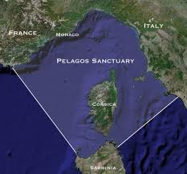







What happens when a user
needs additional data
CISE
Note: Envelopes represent network messages, not traditional mails

Slide 13

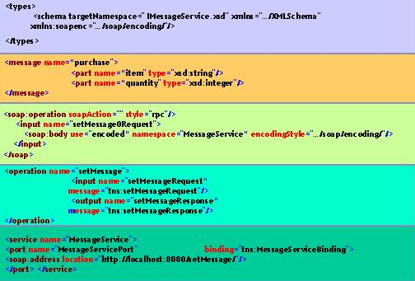
What happens in the
requesting computer
Prepare the request to be sent to the system of the providing authorities in accordance with CISE rules
Search in the local Data Base for a suitable service provided by other authorities through CISE
Retrieve the rules of the service and the address of the system of the providing authorities
CISE

Slide 14
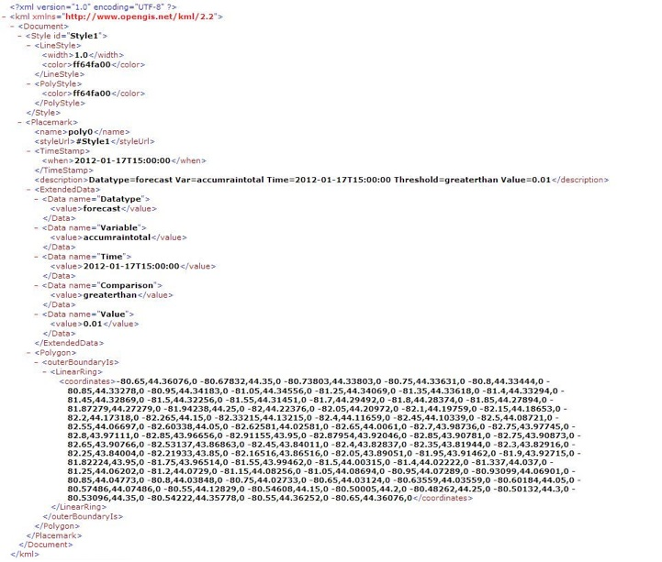
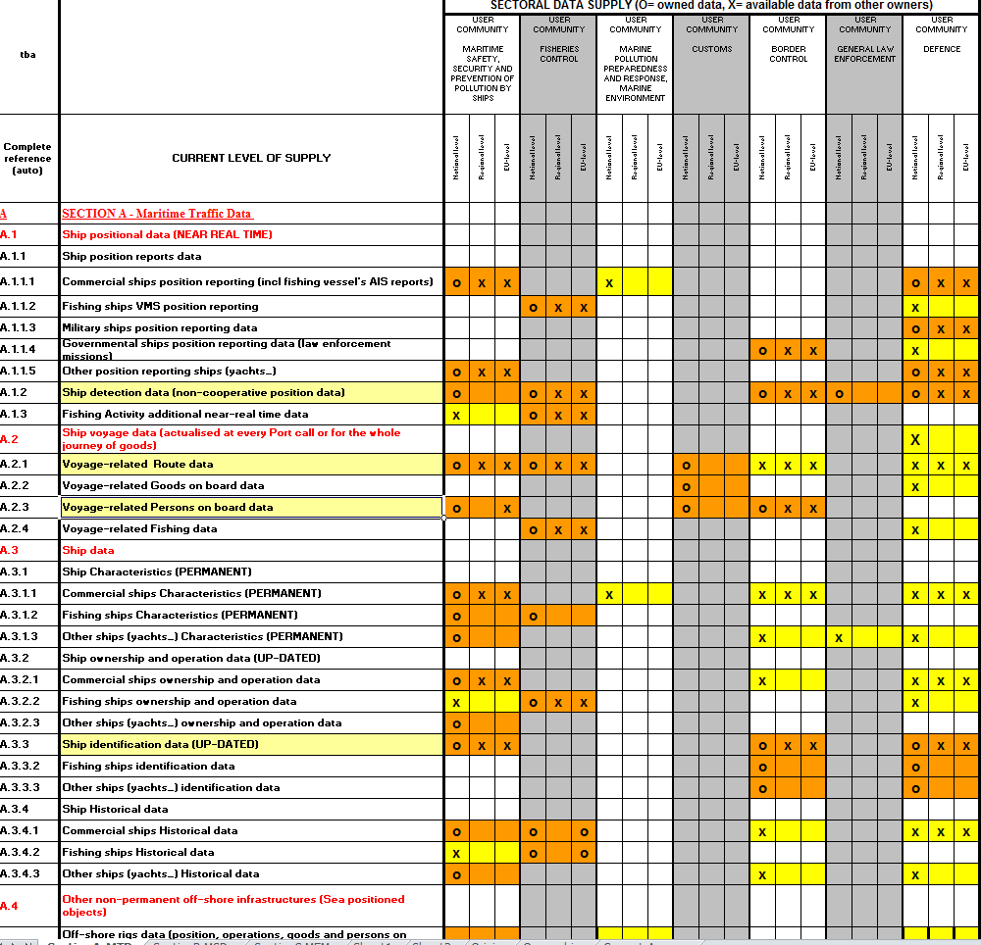
What happens in the
providing computers
Verify requestor’ s access rights based also on the purpose of the request
Package the data to be sent to the requesting authority and send them in accordance with CISE rules
Retrieve the requested data and translate them into CISE Data Model
CISE

Slide 15
Key Objectives of
EUCISE2020
The EUCISE 2020 should be able to execute the end-to-end exchange of data among legacy systems of different sectors in different countries.
It should be possible to “see” data provided by the legacy system X in the Country A on the screen of a legacy system Y in the Country B.
MS A
Legacy System
EUCISE 2020
MS B
Legacy System
MS B
Legacy System
It should be possible to assess that the information has been exchanged in an automated manner, and applying the Access Policies defined by the owner of the system Y.

Slide 16
Desired Features
of EUCISE 2020 solution
Versatility: enable the exchange of a wide range of data.
Neutrality: the proposed solution should be based on open standards.
Scalability: to support the exchange of new data/message formats as well as an enlarged number of participants and an increased flow of data.
Flexibility: the solution should enable the interconnection of participants regardless of the organisational (architectural) solution implemented at national and European level as described in the CISE Hybrid Architecture document.
Reuse of existing solutions should be privileged (e.g. eSens)

Slide 17
Desired Features
of EUCISE 2020 solution
Low impact: the interoperability solution should be designed to generate the lowest cost of implementation at national level.
Low cost of entry: the cost to connect to CISE should be proportional to the type and amount of data exchanged, keeping the “entry” cost at the minimum possible level.
Security: the solution must meet adequate security standards also allowing and managing the possibility to connect through network with different level of security.
Access Rights definition and Management: the data dissemination policy must be decided and implemented by the data owners in accordance with EU legislation on data protection.

Slide 18
EUCISE2020 Validation
Inquiry on a specific suspicious vessel (crew and ownership related)
Detection and behaviour monitoring of IUU listed vessels
Antipollution tasks: investigation (law enforcement)
Suspect Fishing vessel is coopering with other type of vessels (m/v, Container vessel etc.)
Use Cases
Monitoring of all events happening at sea for intervention readiness
Knowledge of risk assessment from neighboring countries authorities to plan basic tactical surveillance
Request for any information confirming the identification, position and activity of a vessel
Request for all available assets in a zone to plan an operation

Slide 19
Thank You
For more information:
https://webgate.ec.europa.eu/maritimeforum/en/cise

Slide 20
Legal interoperability
Authorities involved in cross border information exchange should carefully consider all relevant legislation relating to data exchange, including data protection legislation.
The impact assessment study carried out in preparation of the COM(2014) 451 of 8 July 2014 on CISE outlined that NO legal limitation exists at European Level for the Information relevant to CISE.
Nevertheless, the same communication states that the participation of Authorities in CISE will be on a voluntary basis.

Slide 21
Organisational Interoperability
Organisational interoperability is concerned with how organisations cooperate to achieve their mutually agreed goals.
Organisational interoperability implies integrating business processes and related data exchange.
Organisational interoperability also aims to meet the requirements of the user community by making services available, easily identifiable, accessible and user-focused.

Slide 22
Organisational Interoperability
CISE does not imply a change of responsibility
CISE will not create new IT systems
CISE will not replace or duplicate existing initiatives
CISE will help existing systems to support their users more effectively through better information

Slide 23
The CISE
Hybrid Vision
European Sectorial Node
Regional Node
Public Authority System
Public Authority System 1
CISE Network
National Gateway
(routing)
Public Authority System 2
Public Authority System 1
National Node
(storing/fusion)
Public Authority System 2
Notes:
For Member States:
Flexibility: they can choose their internal organisation
National nodes are optional
Authorities could connect their systems directly to CISE
Low entry cost options
For the CISE specifications:
More requirements / more complexity
The solution should take into account all the possible options

Slide 24
CISE Gateway’s functions
CISE
Gateway
Data Services (Service Model)
Monitoring / Traceability
Translation (Data Model)
Orchestration (Enterprise Service Bus)
Authentication / Access Control
Business Rule Engine
Notes:
To carry out its task the CISE Gateway will include several components, such as:
Data Services (Service Model): to provide services to CISE participants and to use the services provided by CISE participants
Translation (Data Model): to translate the information from and to the CISE “language” (Data Model)
Authentication / Access Control: to ensure that a CISE user is actually who it declares to be and to grant the delivery of the information only to legitimate requesters
Business Rule Engine: to ensure that also complex services can be provided (e.g. subscriptions, alerts, push, pull, etc.)
Orchestration (Enterprise Service Bus): to ensure the smooth coordination of the work of the different components
Monitoring / Traceability: to monitor the activities of the gateway and to allow the log of the events also for legal purposes

Slide 25
Node
Data Fusion
Data Storing
Advanced Value Added Services
Gateway
Data Services (Service Model)
Monitoring / Traceability
Translation (Data Model)
Orchestration (ESB)
Business Rule Engine
Authentication / Access Control
Business Rule Engine
Notes:
Some CISE participants may wish to provide more to other CISE Users (internal or external) by designing and implement a “NODE”, which would include additional functionalities such as:
Data Storing: to allow for a more efficient use of information
Data Fusion: to use all the data available in the MS to enrich the data service provided to other CISE Users
Advanced Value Added Services: other services (e.g. risk analysis, image elaboration, etc.)

Slide 26
CISE Principles
CISE must allow interlinking any public authority in the EU and in the EEA involved in maritime surveillance.
CISE must increase maritime awareness based on need-to-know and responsibility-to-share principles.
CISE must privilege a decentralised approach at EU-level.
CISE must allow interoperability among civilian and military information systems.
CISE must allow interoperability among information systems at the European, national, sectoral and regional level.
CISE must privilege reuse of existing tools, technologies and systems.
CISE must allow seamless and secure exchanges of any type of information relevant for maritime surveillance.
CISE must be system neutral.
CISE must make it possible for information providers to change their service offering.
Notes:
Out of the nine CISE principles, the circled ones are clearly pointing to a hybrid architecture

Slide 27
CoopP Use Cases
No | Use case description | BC+LE | Custom | Defenc | Env | Fish | Safety
13c | Inquiry on a specific suspicious vessel (crew and ownership related) | X |  | X |  | X | X
25b | Antipollution tasks: investigation (law enforcement) |  |  |  | X |  | X
37 | Monitoring of all events happening at sea for intervention readiness |  |  | X |  |  | X
44 | Request for any information confirming the identification, position and activity of a vessel of interest | X | X | X |  | X | X
57 | Request for all available assets in a zone to plan an operation | X | X | X |  | X | X
63 | Knowledge of risk assessment from neighboring countries authorities in a given sea area to plan basic tactical surveillance | X | X | X |  | X | X
70 | Suspect Fishing vessel is coopering with other type of vessels (m/v, Container vessel etc.) | X | X | X |  | X | X
93 | Detection and behaviour monitoring of IUU listed vessels |  |  |  |  | X
These use cases are quite representative and well documented, thanks to the work of TAG and of the CoopP, but they are far from being exhaustive: EUCISE 2020 should go forward

Slide 28
Desired Features
of EUCISE 2020 solution
EUCISE 2020 should achieve technical and operational consistency as well as complementarity with existing maritime information-exchange systems.
Reuse of existing solutions should be privileged (e.g. eSens).
The information exchange systems enshrined in EU law (SSN, EUROSUR, NSW, etc.), as well as other non-compulsory information-exchange systems already implemented at EU and regional level should be taken into account.
Relevant agencies (among others EFCA, EMSA, FRONTEX and EDA) as well as competent Commission services should be involved whenever possible and needed.

